Slide 1

Musical
instruments
singers
composers
MUSIC
songs
orchestra
pop
music
jazz
rock

Slide 2
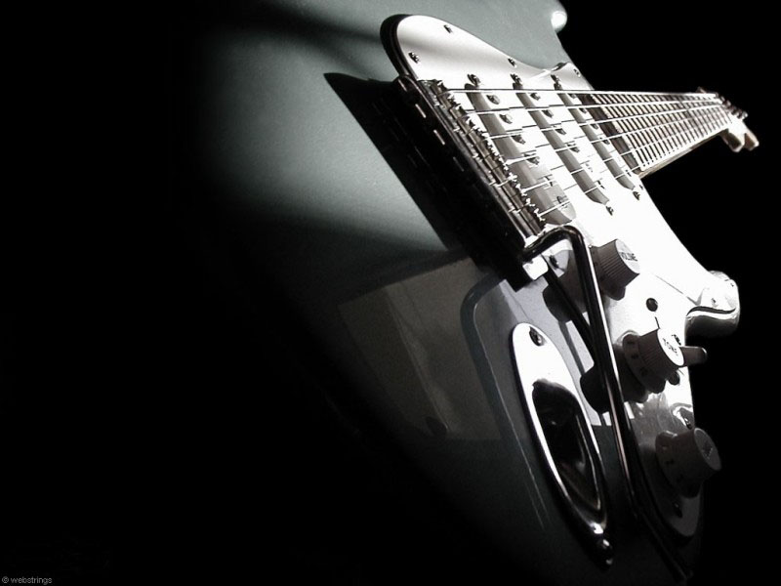
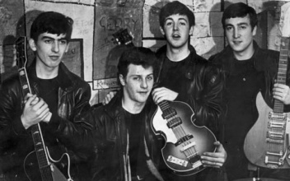
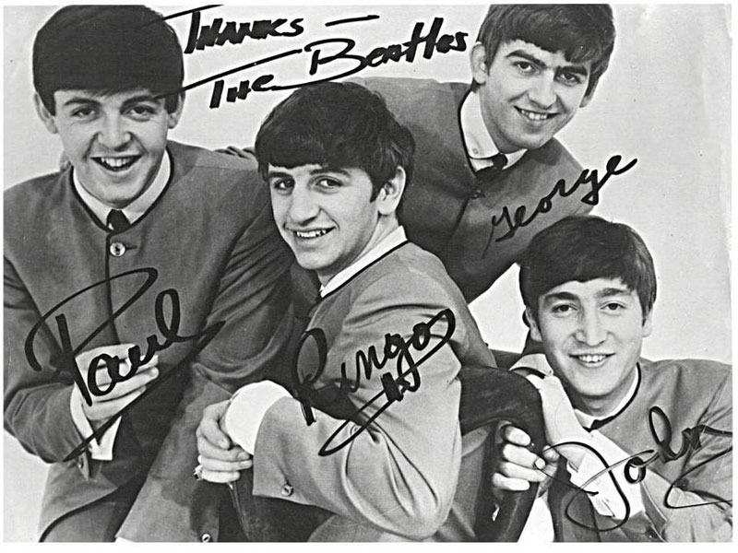
Beatles

