Slide 1
The Seasons
in England.

Slide 2
Put the words into correct order to make up sentences:
families/English/to/their/like/spend/holidays/the/in/country/
English/is/like/a/the/countryside/of/carpet/flowers/many/
is/snow/in/there/little/winter/England/in/
the/is/English/hot/summer/very/never/
children/much/English/to/very/like/football/play/

Slide 3
Check yourselves:
English families like to spend their holidays in the countryside.
The English countryside is like a carpet of many flowers.
There is little snow in winter in England.
The English summer is never very hot.
English children like to play football very much.

Slide 4
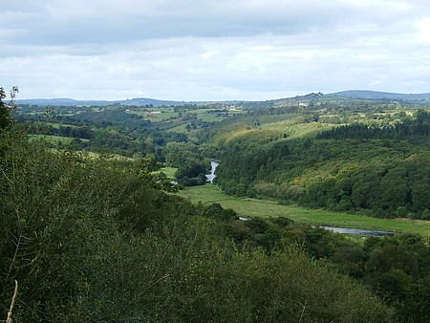
The Seasons in England.
English families like to spend their holidays and the weekends in the countryside.

Slide 5
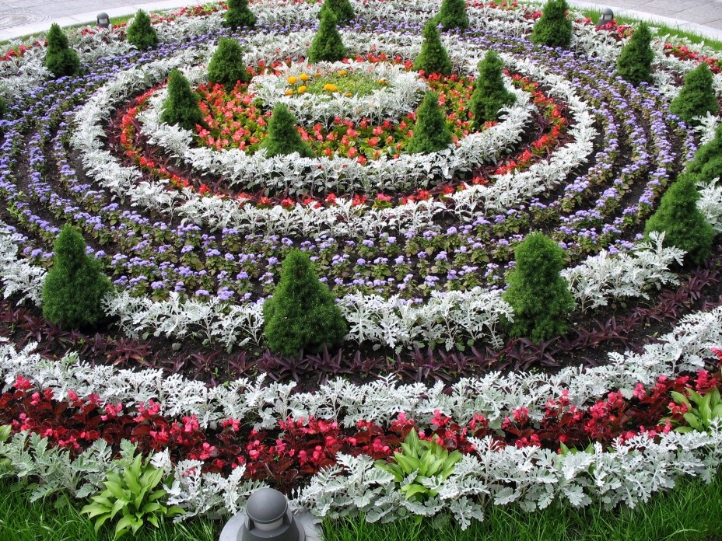
The English countryside is like a carpet of many flowers in every season.

Slide 6
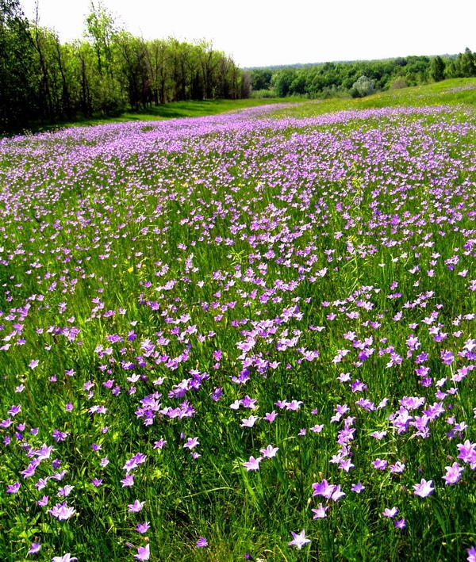
In spring and summer the fields, the meadows and the forests are light green and dark green.

Slide 7
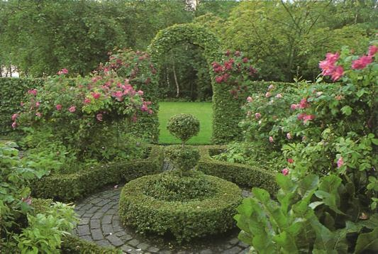
The gardens are red, blue, yellow and white with flowers.

Slide 8
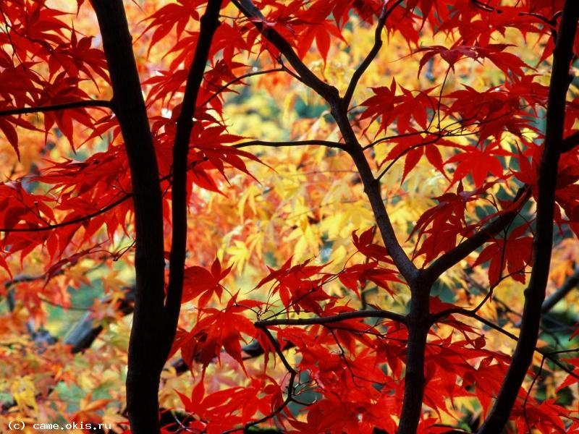
In autumn the leaves on the trees change their colour from green to yellow, brown, red and orange.

Slide 9
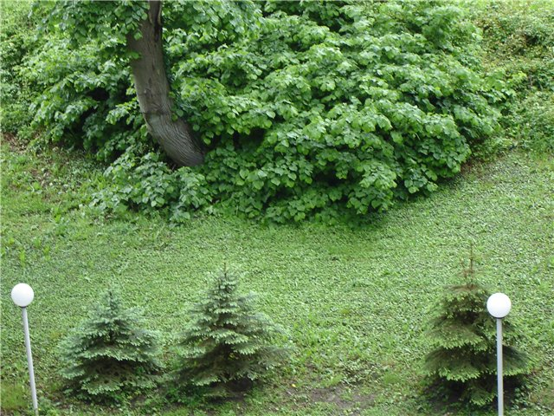
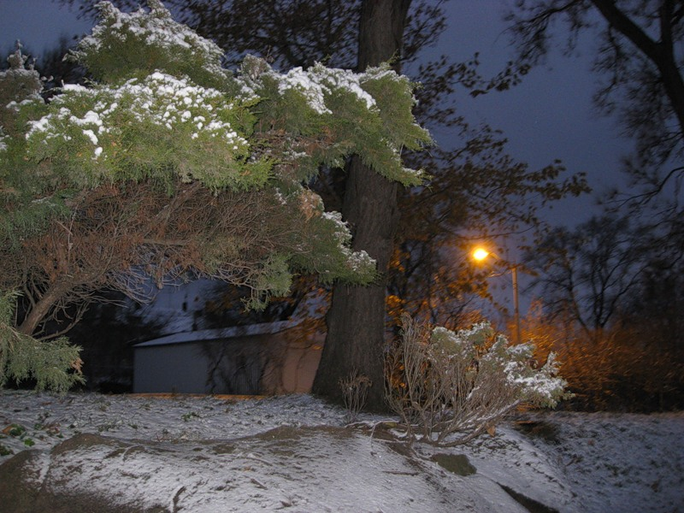
The English summer is never very hot
and in winter it is not very cold.

Slide 10
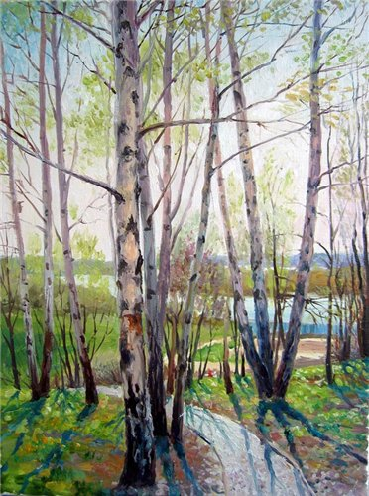
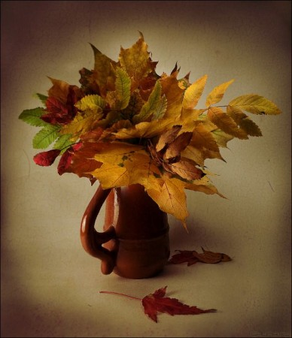
Spring and autumn are cool.

Slide 11
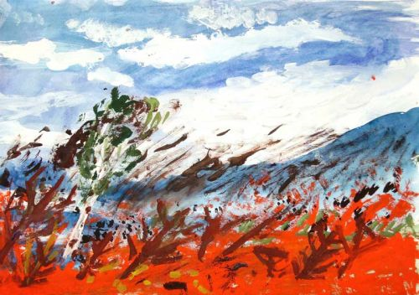
Cold wind blows in winter from the sea, in summer the winds are cool.

Slide 12

There is little snow in winter, and it never stays on the ground for long.

Slide 13
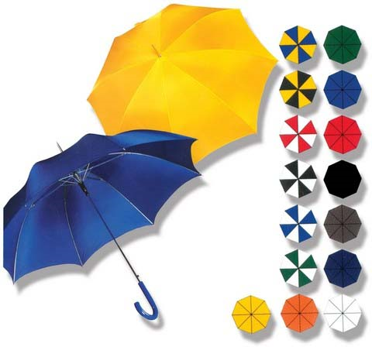
But there is much rain in England all the year round.

Slide 14
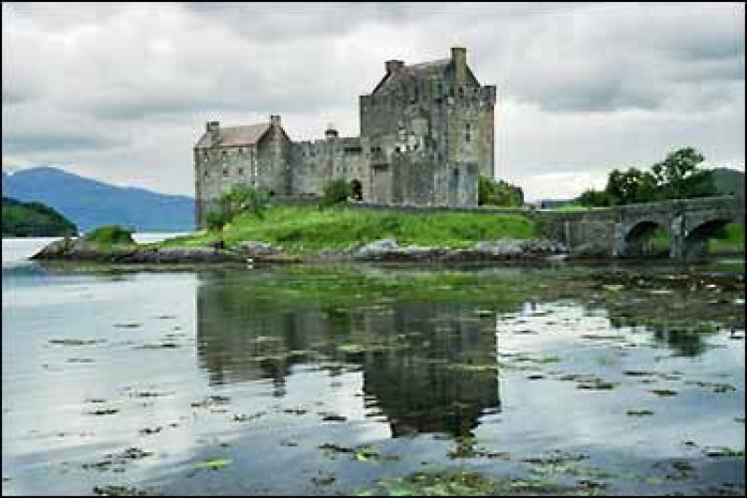
The weather is very changeable.

Slide 15
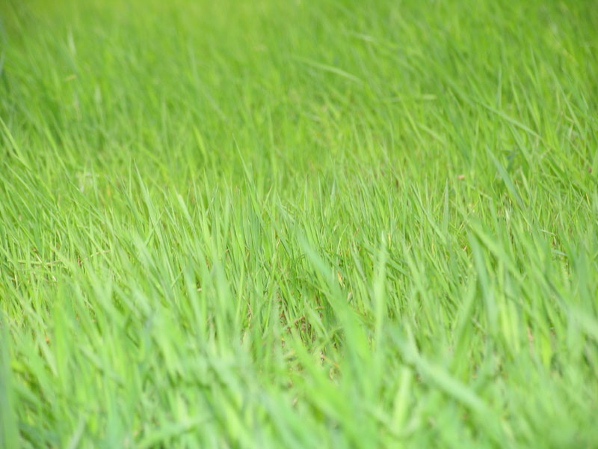
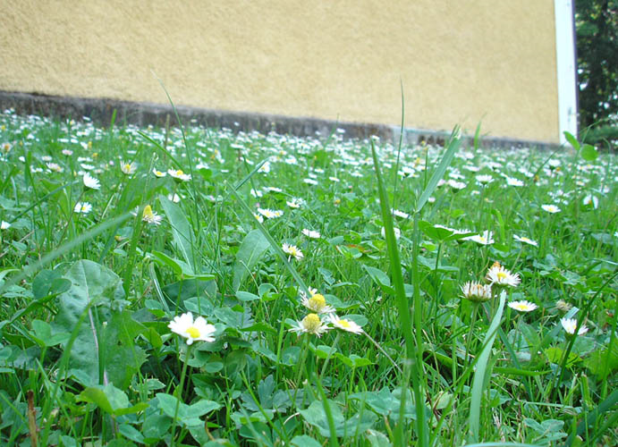
The grass in the mountains is green all the year round.

Slide 16
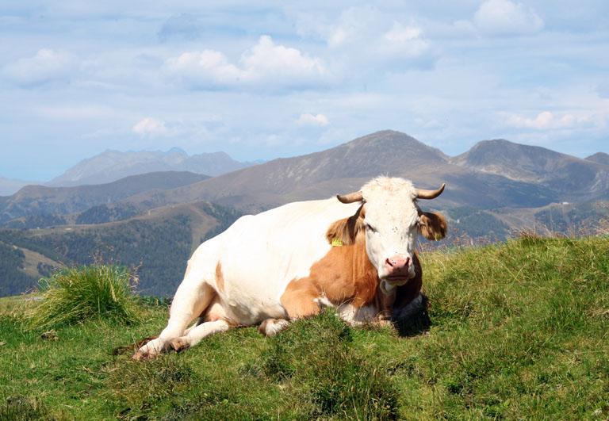
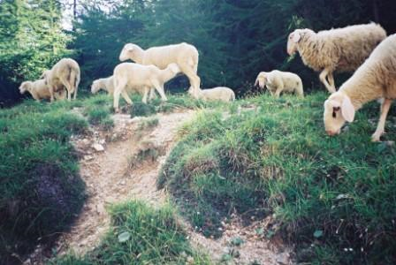
That’s why you can see many cows and sheep in the meadows.

Slide 17
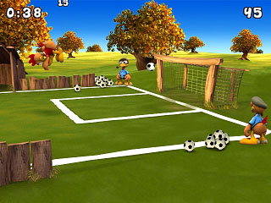

English children like to play football very much.
They can play football even in winter because the football fields are always green.

Slide 18
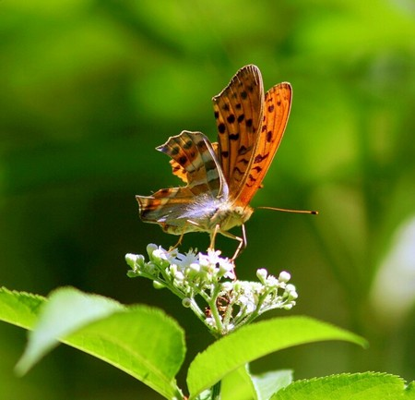

All children like summer best of all because it is the season of their holidays.

Slide 19
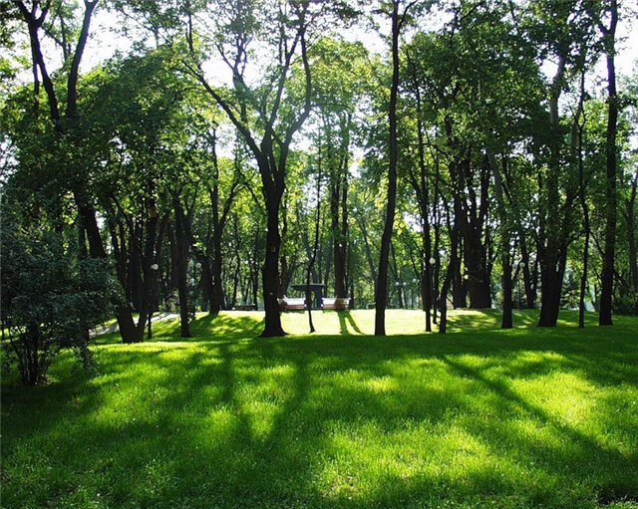

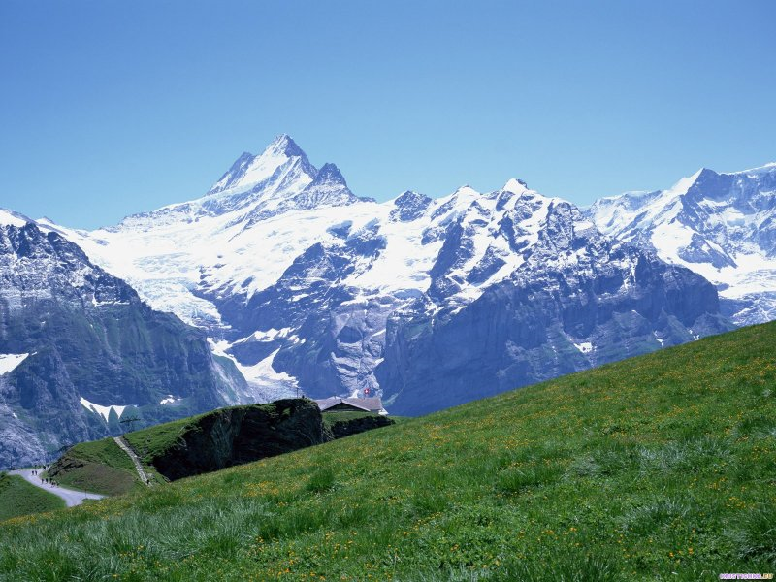
They can go to the seaside, play in green parks and walk in the mountains.

