Slide 1
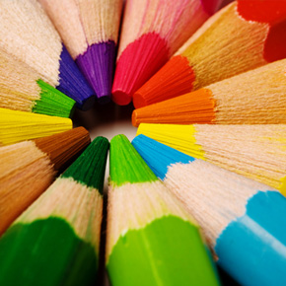
My Hobbies and
Interests

Slide 2
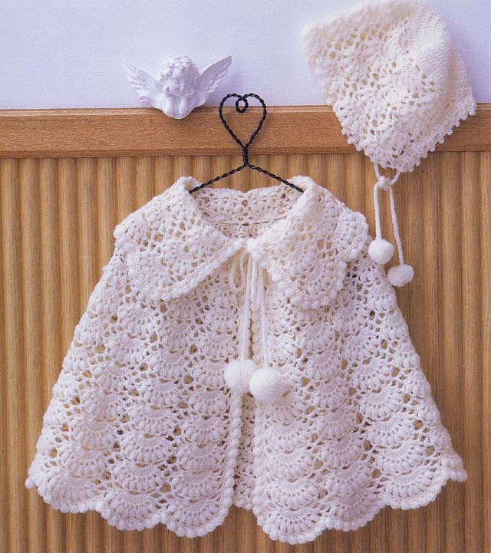
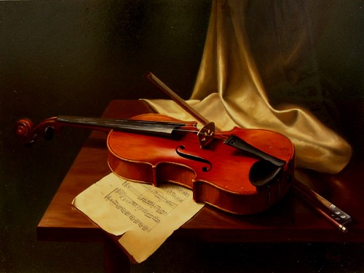


A hobby
is an activity or interest
that is undertaken for pleasure,
typically done during one’s leisure time

Slide 3
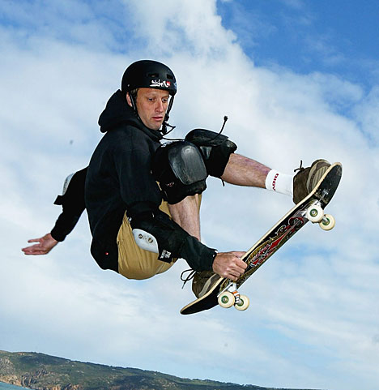
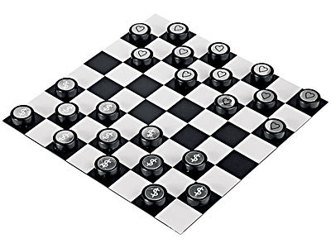

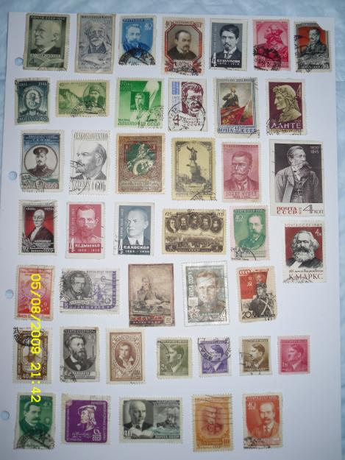
The most
common hobbies
are :

Slide 4
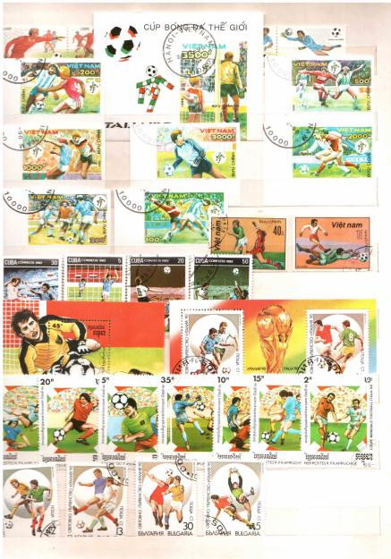

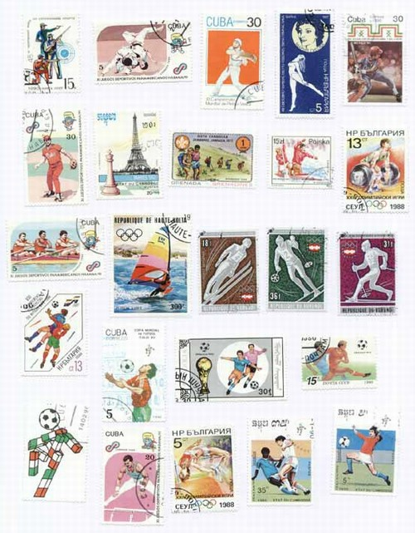
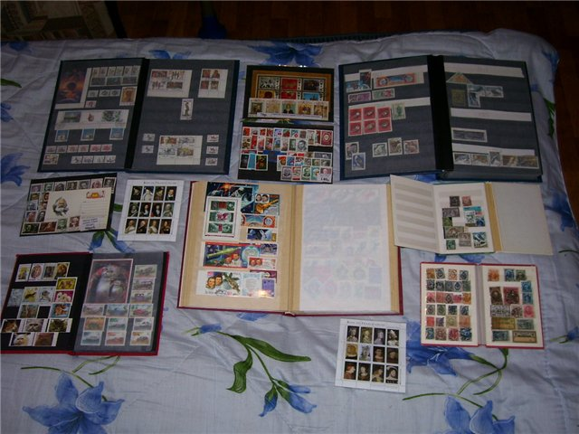
Stamp collecting
called philately
This is the most popular hobby.
Each stamp means something
is associated with some events.

Slide 5

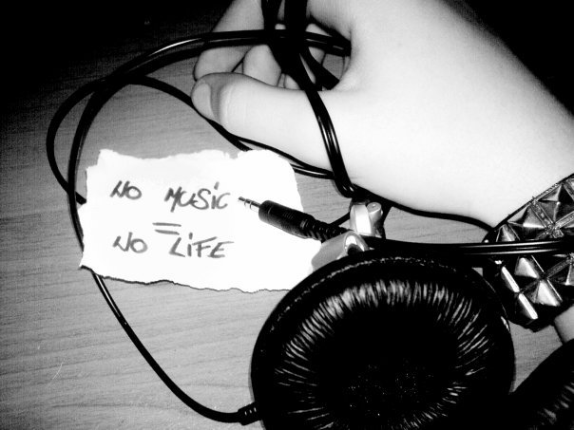
Listening to the music
is melomania
Is an excessive
passion
to music

Slide 6
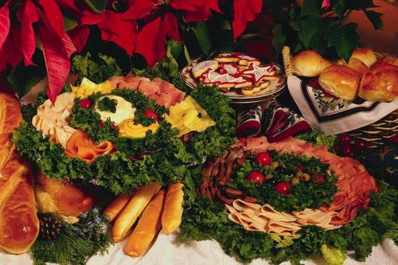
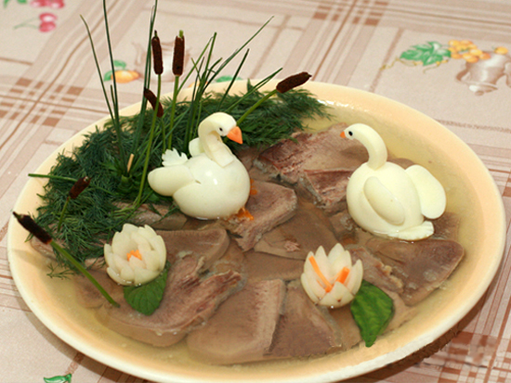
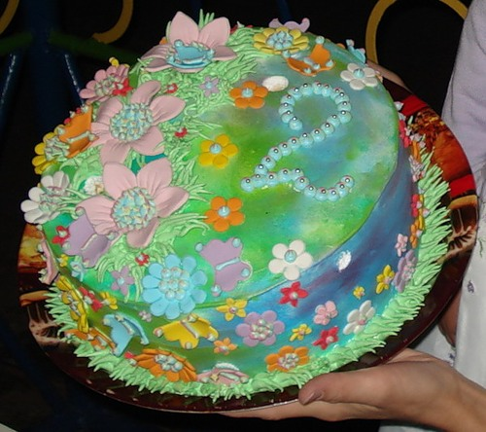
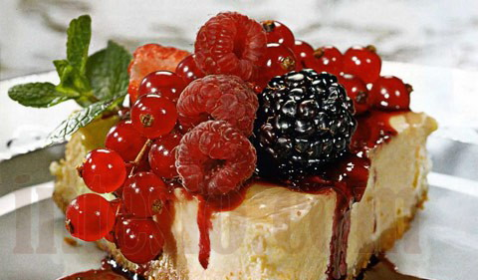
Cookery
Area of human activity
associated with cooking.
Includes a set of technologies,
equipment and recipes

Slide 7






Playing computer games
is gambling
Overreliance
on
computer games

Slide 8


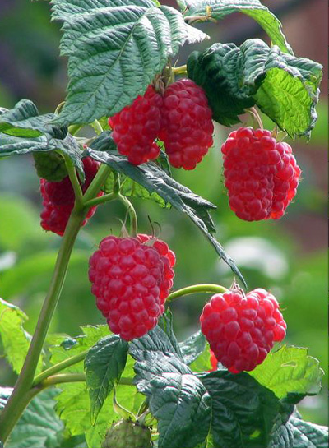


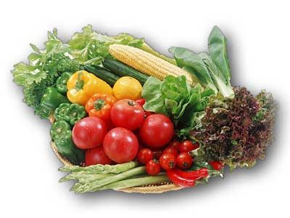
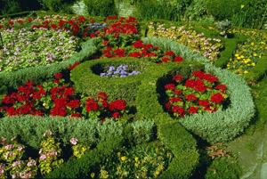
Horticulture
One of the finest
human hobbies,
besides a purely practical significance
have an enormous
creative and aesthetic value

Slide 9
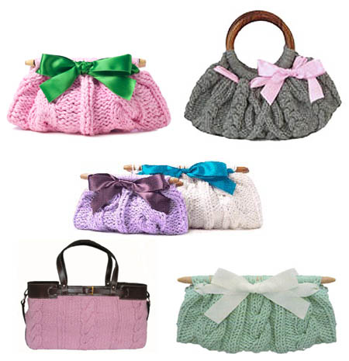
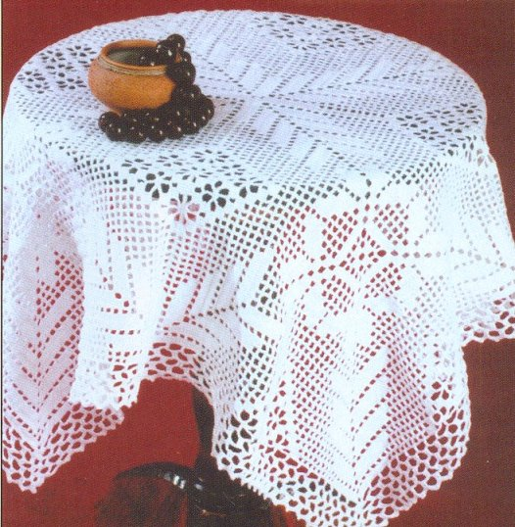
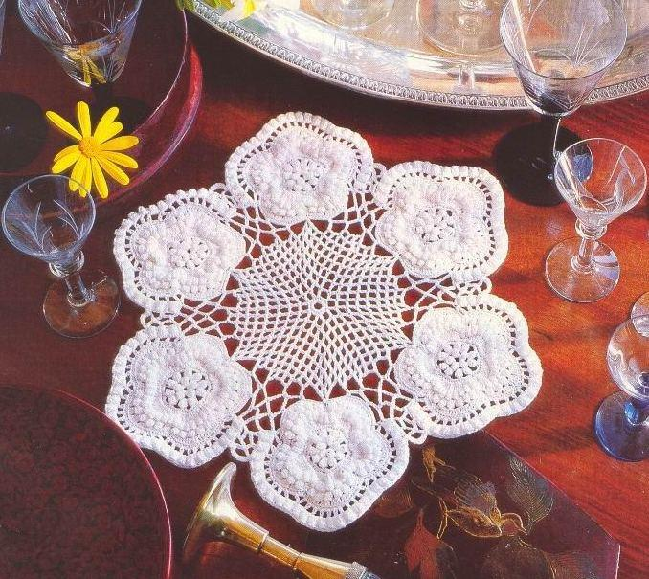

Knitting
The process
of manufacturing products
from continuous filaments
by bending them in the loop
and connecting loops with each other
using simple tools to manually
or on a special machine

Slide 10
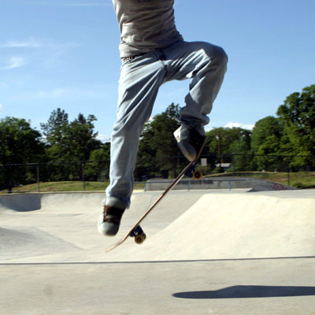
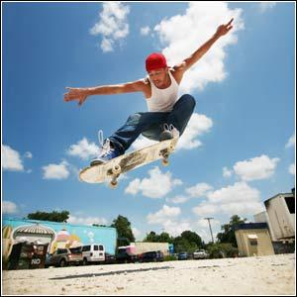
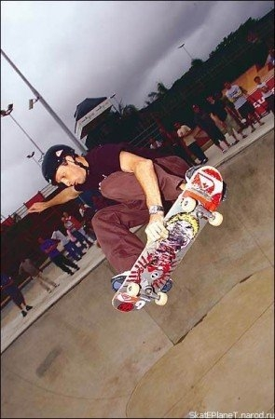
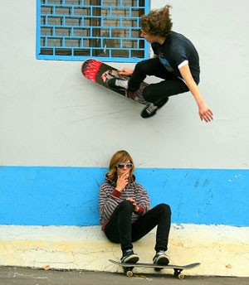
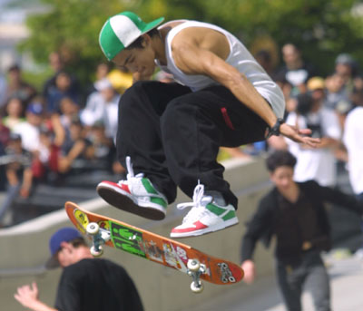
Skateboarding
Extreme sport,
which includes skating
and the performance of different tricks
on a skateboard.
Person involved in skateboard,
skateboarder or skater called

Slide 11
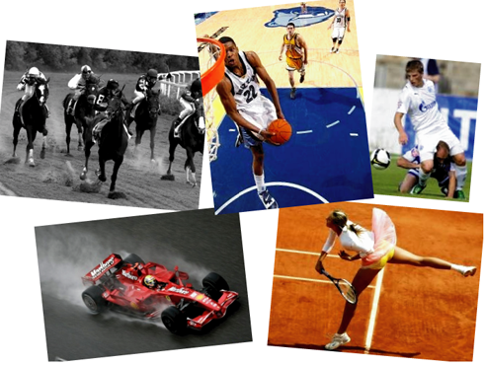
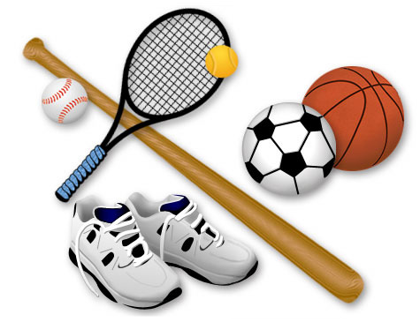
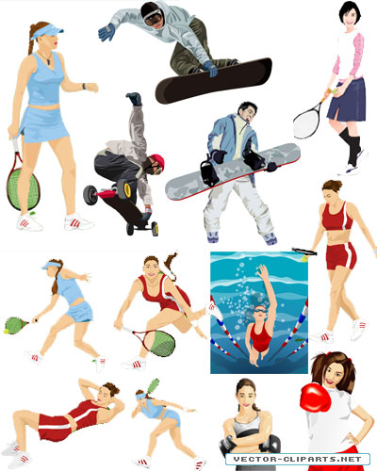

My hobby
is sport.
In particular

Slide 12
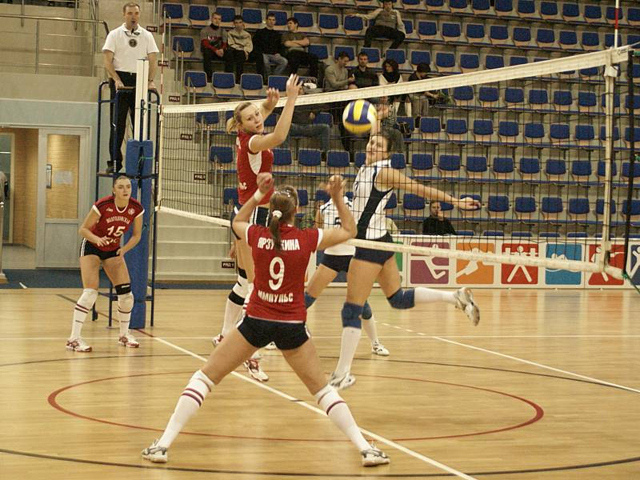
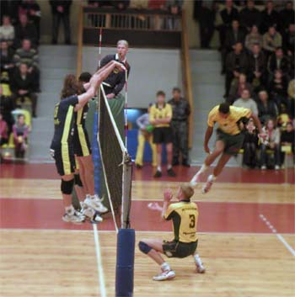
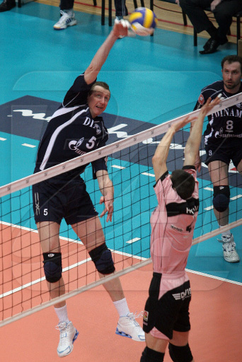
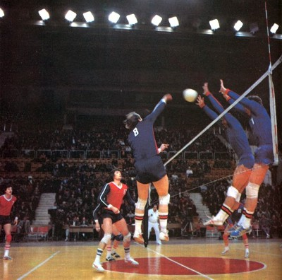
Volleyball
Sport, team sports game
in which two teams
compete on a special area,
divided by a net,
trying to send the ball to the opponent so
that he landed on the landing of the enemy,
Or defensive player made a mistake

Slide 13
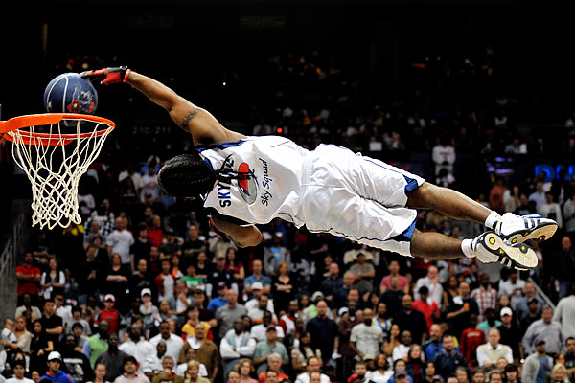
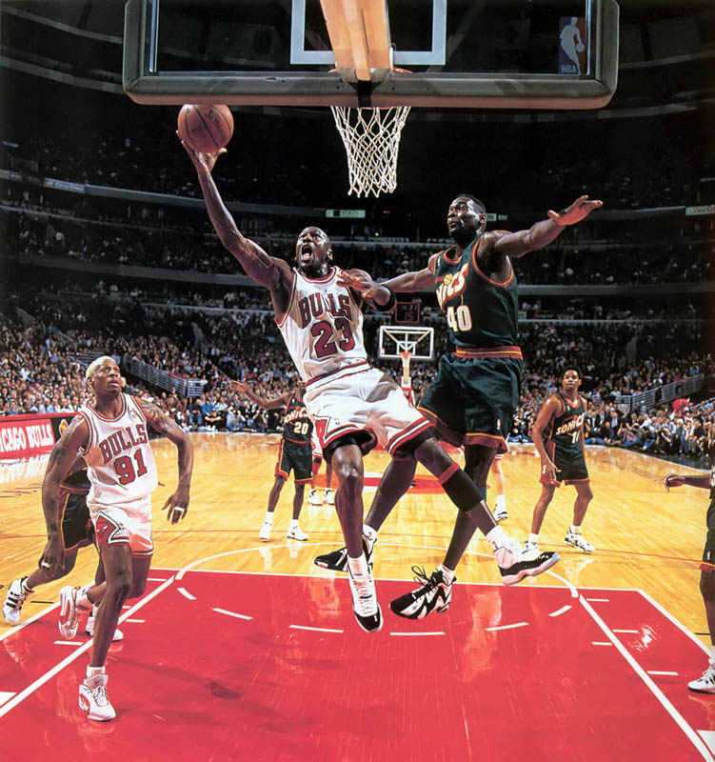
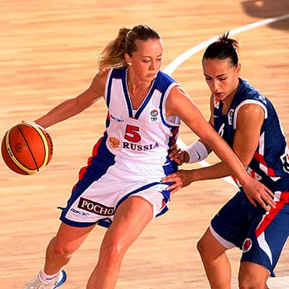
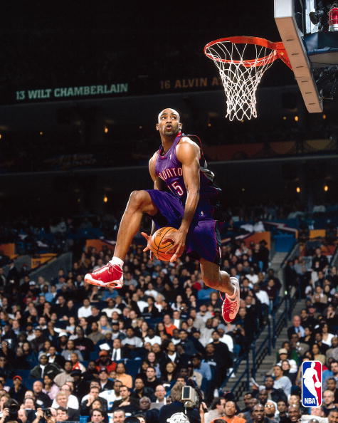
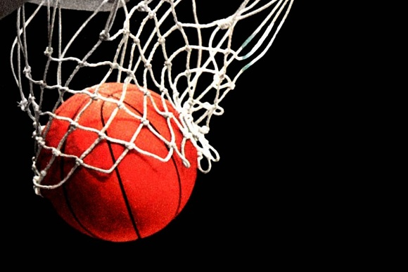
Basketball
Sports team play with the ball.
In basketball played by two teams,
each consist of five players.
The goal of each team –
to throw the ball
in his hands with a ring net (basket) the opponent
and prevent the other team take the ball
and throw it in your basket.

