Slide 1
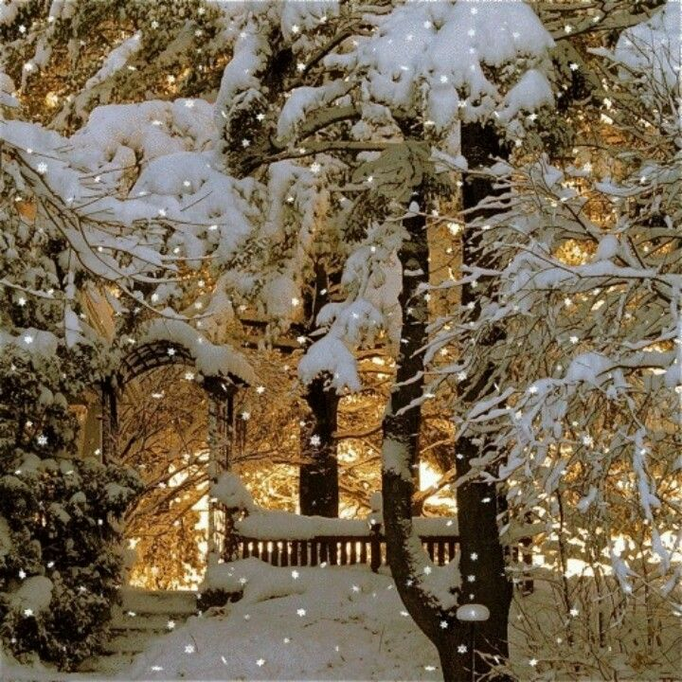
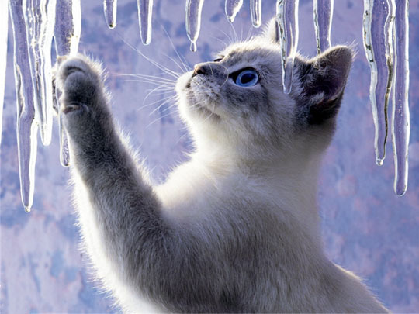
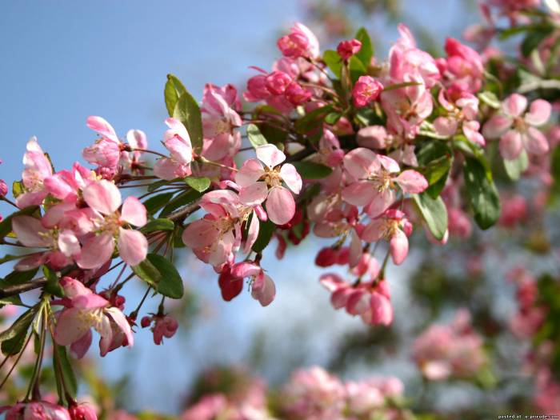
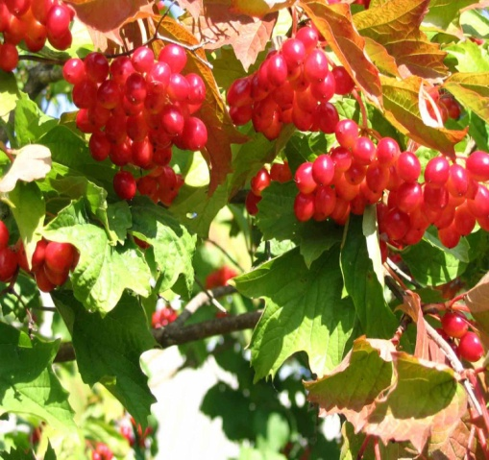
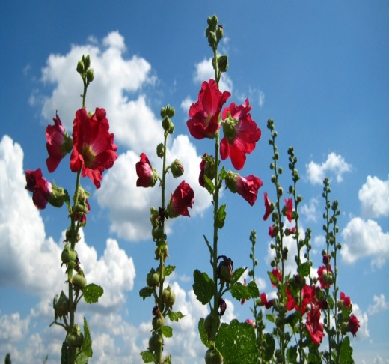
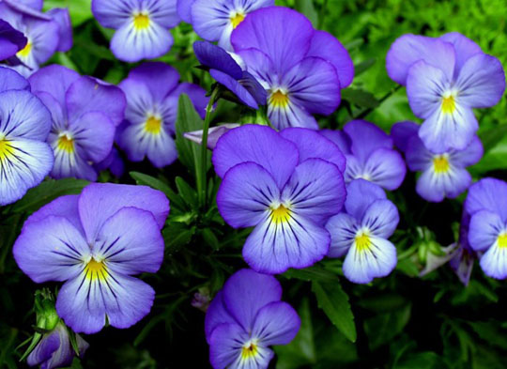
My Favourite Season.
Form 2
English teacher : Svitlana Motyka
/ School of Smykivtsi /

Slide 2
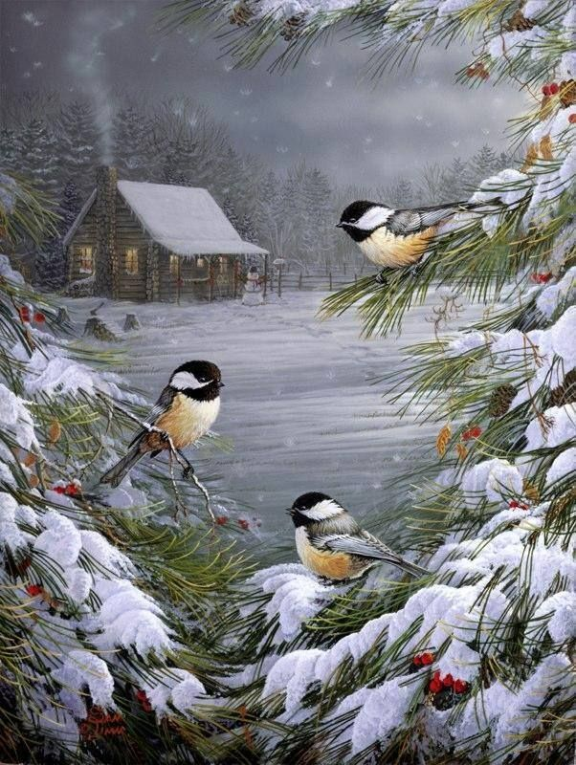
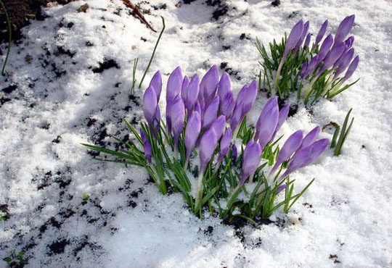
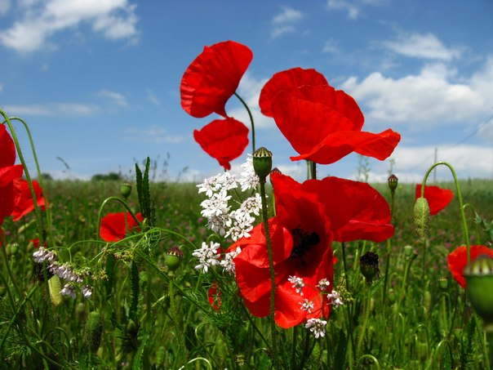
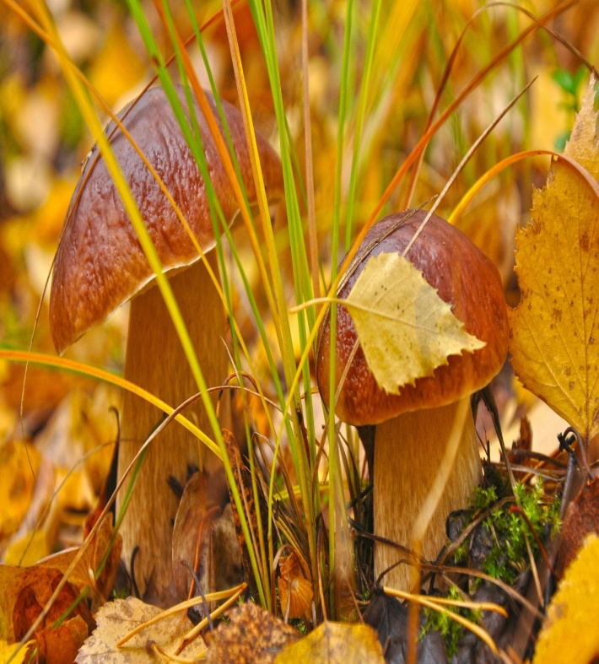
There are four seasons in a year.
Winter Spring Summer Autumn

Slide 3
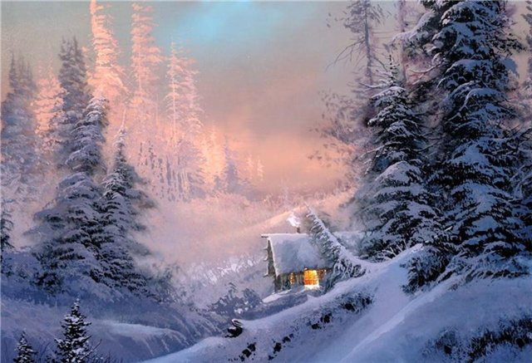
There are three months in each season.
Winter months are December, January and February.

Slide 4
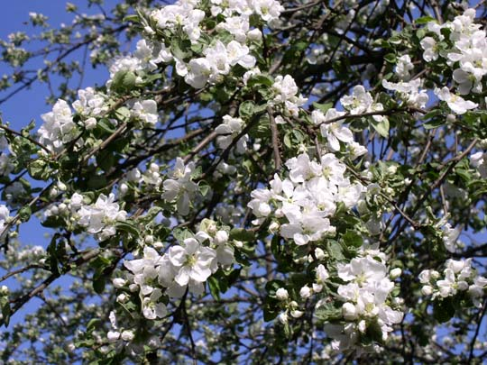
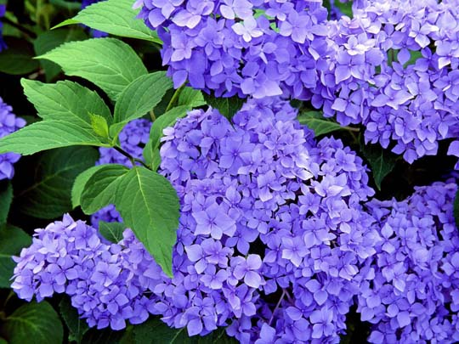
March, April and May are spring months.

Slide 5
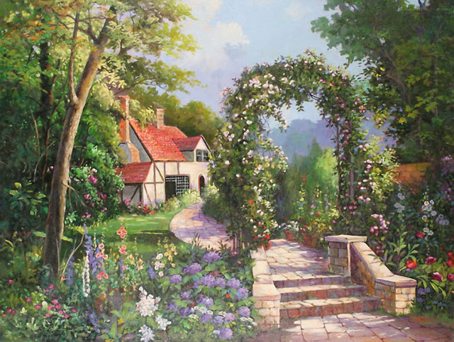
Summer months are June, July and August .

Slide 6
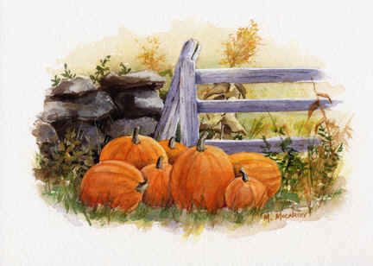
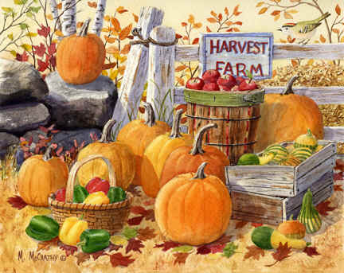
Autumn months are September, October and November.

Slide 7
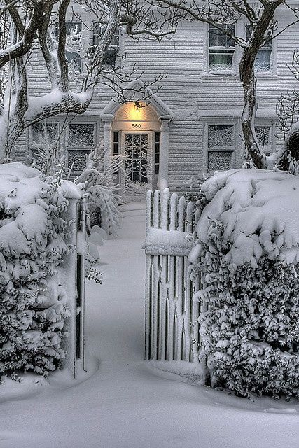
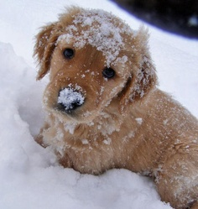
It is winter.
It is cold. It is snowing.
The trees are white.
We can make a snowman.

Slide 8
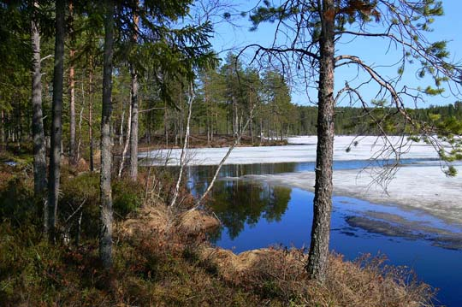
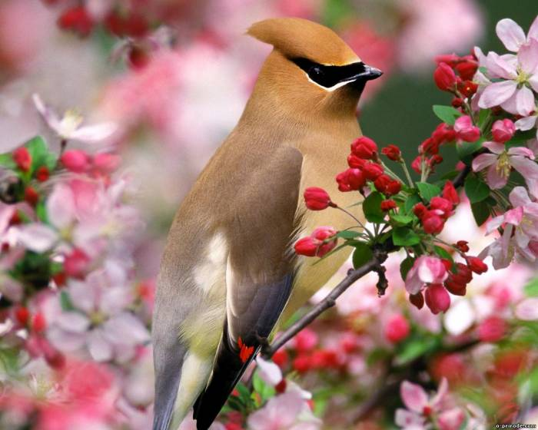
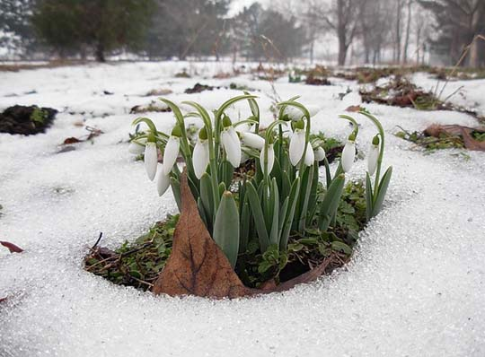
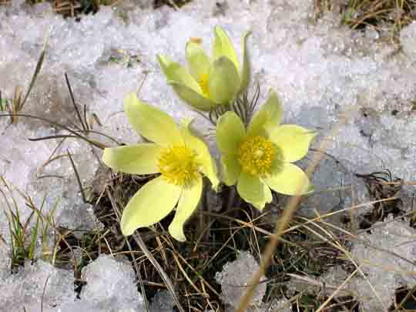

It is spring.
It is sunny.
The trees are green.
We can see birds.
They sing sons.

Slide 9
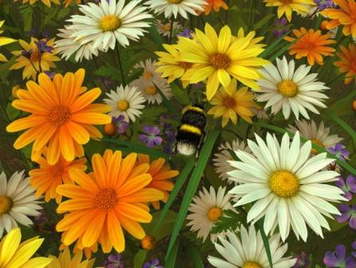

It is summer.
It is sunny and hot.
We do not go to school.
We can swim and have fun.

Slide 10
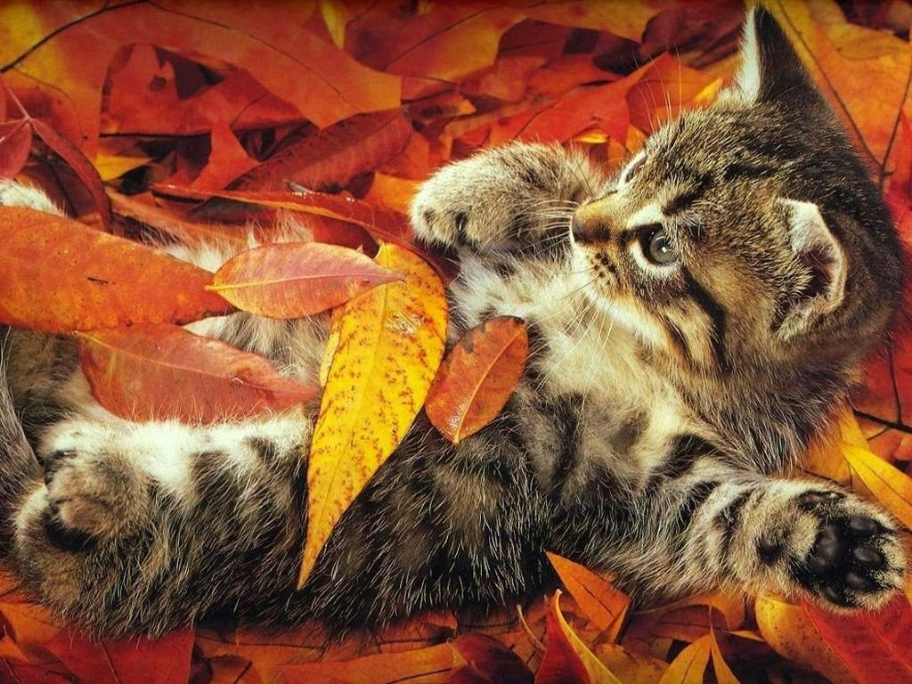
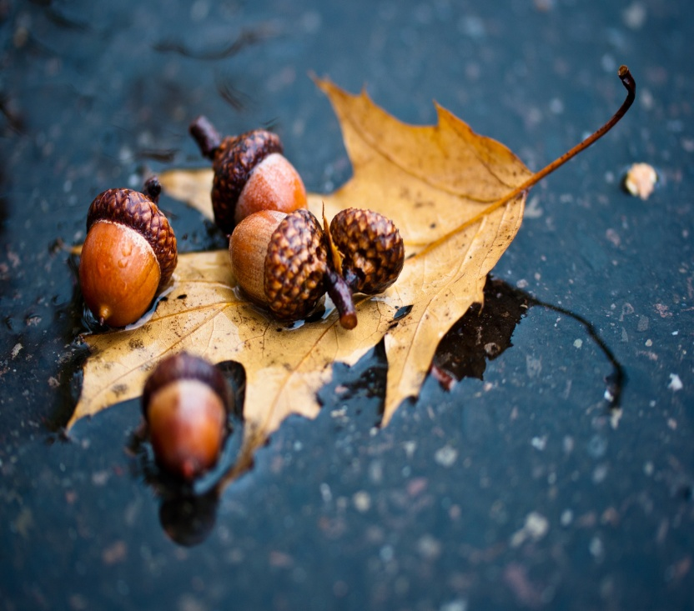
It is autumn.
It is windy and rainy.
The trees are yellow, brown and red.
We can fly a kite.

Slide 11
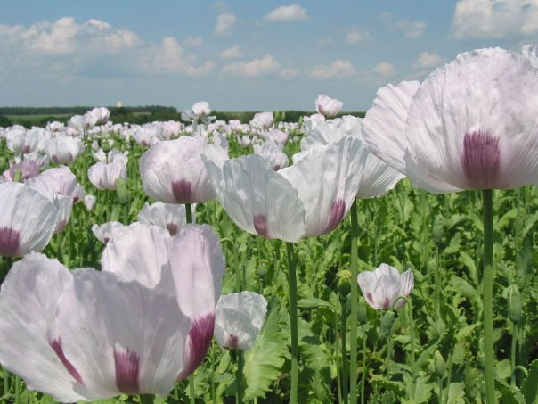
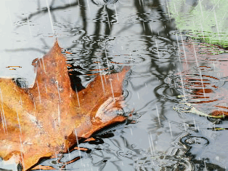
What`s the weather like ?
It is sunny.
It is hot.
It is raining.

Slide 12

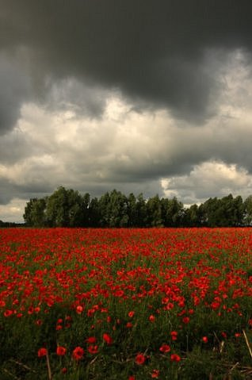
It is cloudy.
It is stormy.

Slide 13
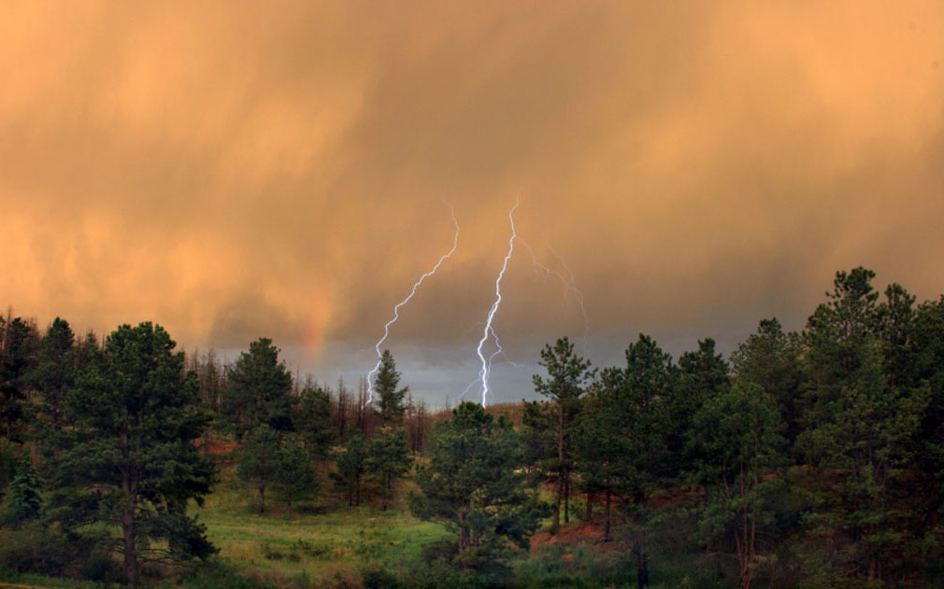
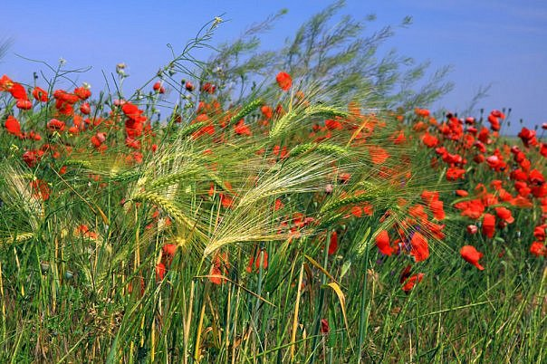
It is lightning.
It is windy.

Slide 14
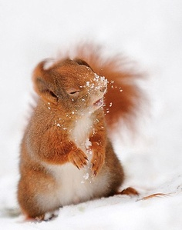
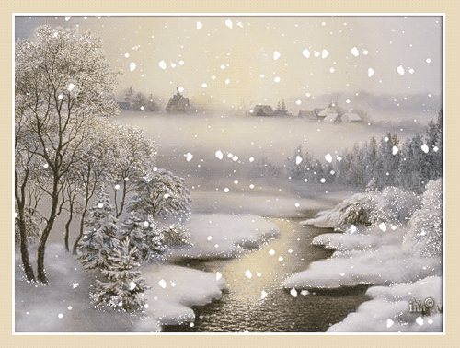
It is snowing.
It is cold.
It is foggy.

Slide 15
Questions.
1.How many seasons are there in a year?
2.What seasons do you know?
3.How many months are there in each season?
4.What are winter months ?
5.What are spring months?
6.What are summer months ?
7.What are autumn months?

