Slide 1
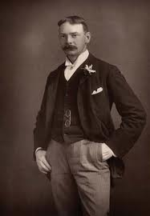
Jerome
Klapka
Jerome
2 May 1859 – 14 June 1927

Slide 2
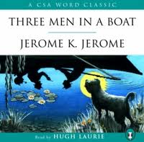
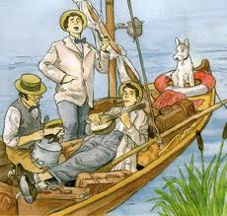
Jerome Klapka Jerome was an English writer and humorist.
The most famous his work is a humorous travelogue
Three Men in a Boat.

Slide 3
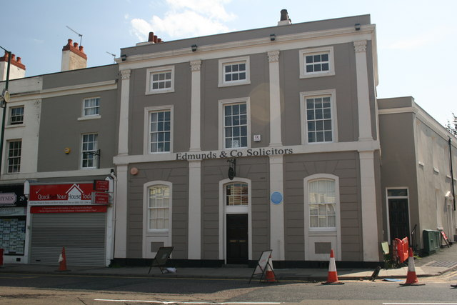
Jerome Klapka Jerome was born in England on May 2, 1859 into the family of ruined businessman.
Birthplace of Jerome K Jerome

Slide 4
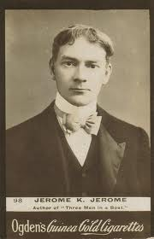
Jerome's childhood was poor and sad. He could not finish school because his father died in 1871 and the boy had to begin working to support his family.

Slide 5
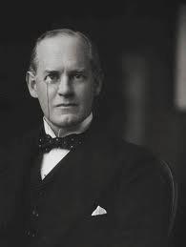
First he worked as a clerk. Later he took up teaching journalism and acting. For three years he was an actor and had to play different parts. He had very little money and often went hungry and had no place to sleep. In his free moments Jerome tried to write. He wrote plays, stories and articles, but nothing was published.

Slide 6
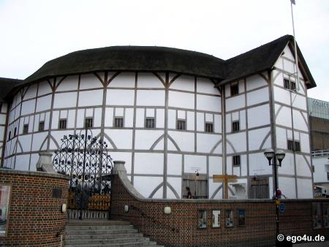
His first literary success was a one-act comedy which was performed in the Globe theatre in London in 1886.

Slide 7
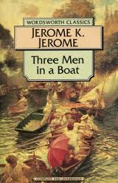

In 1889 Jerome's best book
Three Men in a Boat
came out.

Slide 8
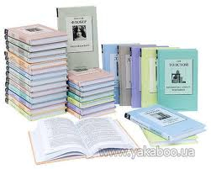

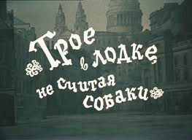
The book was translated into many European languages.

Slide 9
Jerome
Klapka
Jerome
2 May 1859 – 14 June 1927

