Slide 1
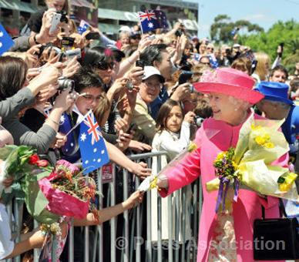
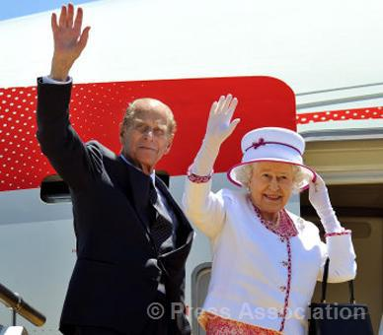
Royal Visit to Australia
October , 2011

Slide 2
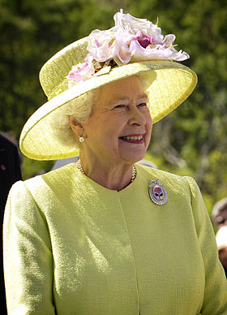
May GOD save the Queen ....long live Majesty !

Slide 3
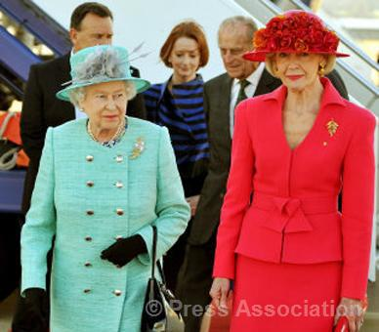
The Queen is met by the Australian Governor General, Quentin Bryce, after arriving in Canberra, Australia, at the start of an 11 day tour, 19 October 2011.

Slide 4
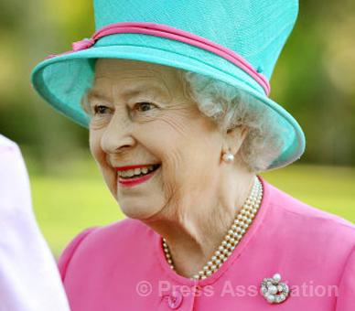
The Queen during a tour of the grounds of Government House in Canberra, during the second day of an 11 day Royal Tour of Australia, 20 October 2011.

Slide 5
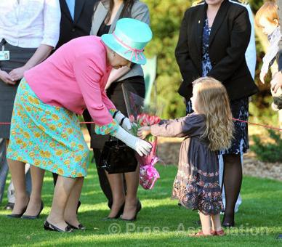
The Queen receives flowers from a little girl in the grounds of Government House in Canberra, during the second day of an 11 day Royal Tour of Australia, 20 October 2011.

Slide 6
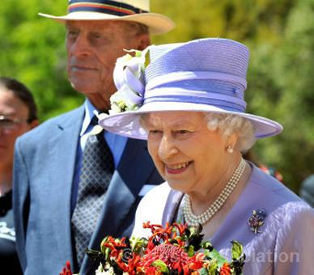
The Queen and The Duke of Edinburgh at the Canberra Floriade (Flower Show) during the second day of an 11 day Royal Tour of Australia, 20 October 2011.

Slide 7
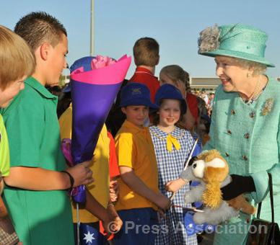
The Queen meets local school children after arriving in Canberra, Australia, at the start of an 11 day tour, 19 October 2011.

Slide 8
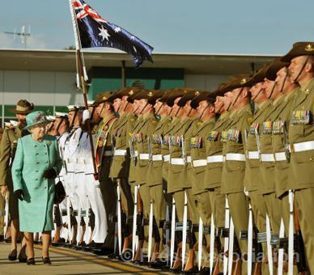
The Queen inspects a Guard of Honour after flying into Canberra Airport, Australia, at the start of an 11 day tour, 19 October 2011.

Slide 9
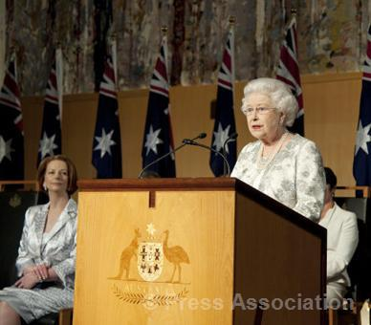
The Queen makes a speech during a Parliamentary Reception at Parliament House, Canberra, Australia, 21 October 2011.

Slide 10
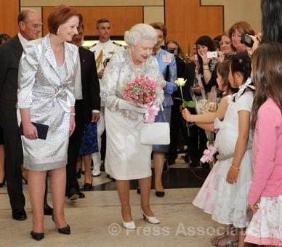
The Queen, accompanied by Australian Prime Minister Julia Gillard, is presented with flowers by a little girl after a a Parliamentary Reception at Parliament House, Canberra, Australia, 21 October 2011.

Slide 11
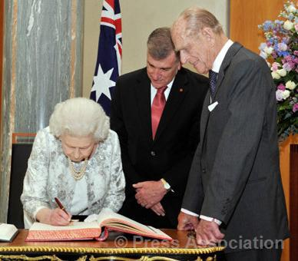
The Queen, accompanied by The Duke of Edinburgh, signs the visitor book after a Parliamentary Reception at Parliament House, Canberra, Australia, 21 October 2011.

Slide 12
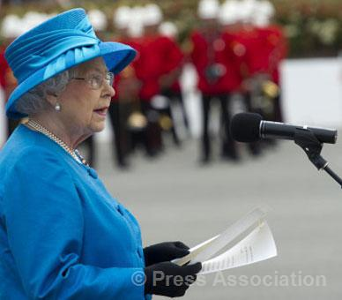
The Queen makes a speech during a visit to the Australian Royal Military College where Her Majesty presented new Colours (Regimental Flags) to the college, Duntroon, Canberra, Australia, 22 October 2011.

Slide 13
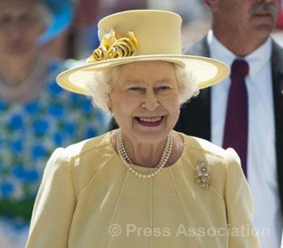
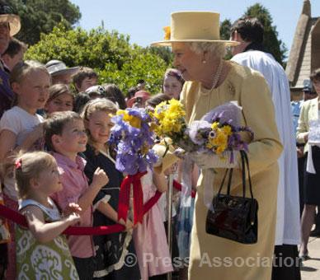
The Queen outside St John the Baptist Church after attending morning service, Canberra, Australia, 23 October 2011.

Slide 14
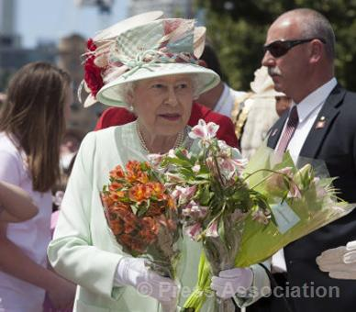
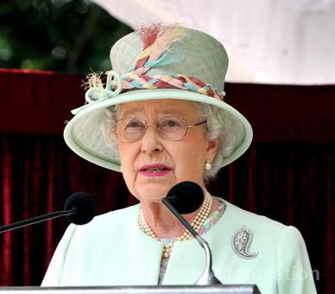
The Queen meets crowds of well wishers during a visit to the city of Brisbane, Queensland, Australia, 24 October 2011.

Slide 15
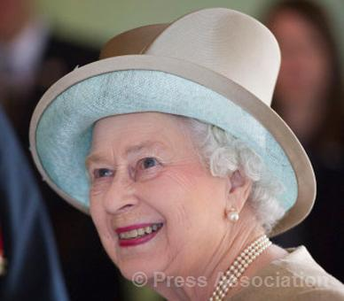
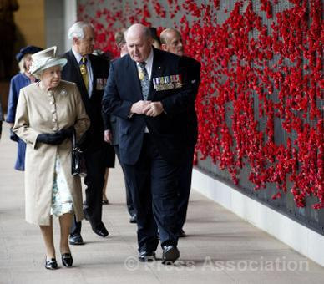
The Queen with General Peter Cosgrove, Chairman of the Council of the Australian War Memorial, during a visit to the Australian War Memorial in Canberra, Australia, 25 October 2011.

Slide 16
The Queen meets crowds of well wishers with flowers during a walk about in Federation Square, Melbourne, Australia, 26 October 2011.

Slide 17
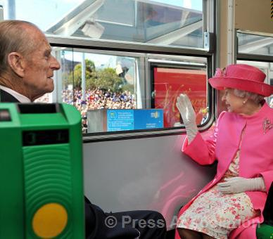
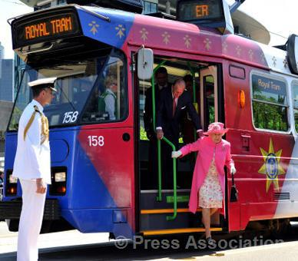
The Queen and The Duke of Edinburgh take the electric tram through Melbourne city centre, passing crowds of well wishers along the way, Melbourne, Australia, 26 October 2011.

Slide 18
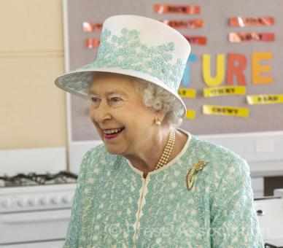
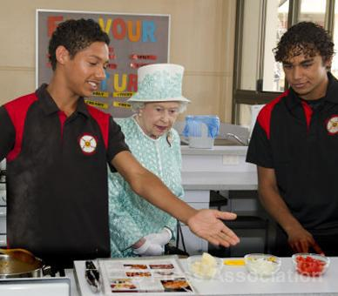
The Queen watches students making 'roo stew' during a visit to the Home Economics Department at Clontarf Aboriginal College in Perth, Australia, 27 October 2011.

Slide 19
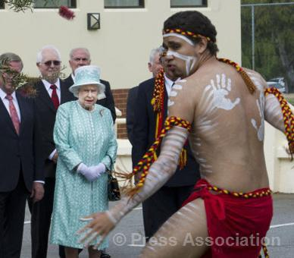
The Queen watches a cultural display during a visit to the Clontarf Aboriginal College in Perth, Australia, 27 October 2011. The display was performed by a dance troop from the Nyungar people - the original inhabitants of the region surrounding the college - and featured spirit-warrior and emu dances.

Slide 20
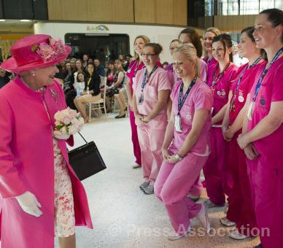
The Queen is greeted by nurses during a visit to officially open the new Royal Children's Hospital in Melbourne, Australia, 26 October 2011.

Slide 21
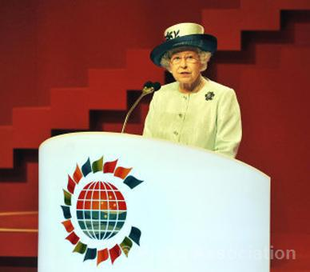
The Queen makes a speech at the 2011 Commonwealth Heads of Government Meeting (CHOGM) in Perth, Australia, 28 October 2011.

Slide 22
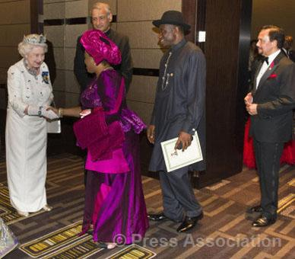
The Queen Elizabeth meets Patience Jonathan, wife of Goodluck Jonathan, the President of Nigeria (centre) at a banquet for Commonwealth leaders in Perth, 28 October 2011. The Sultan of Brunei can be seen on the right.

Slide 23
The Queen and The Duke of Edinburgh wave farewell to well-wishers as they board a plane at Perth International Airport at the end of their 11-day visit to Australia where Her Majesty opened the Commonwealth Heads of Government Meeting, 29 October 2011.

Slide 24
Penny Mullan God Bless the Queen!!!
Eduardo Matias De Santis God Save the Queen and bless the UK!!!
Balu Shobha ITS MY DEAR QUEEN MOTHER!
Michael Bemrose As a Australian I love being part of the British Royal Monarchy. Long live the QUEEN.
Kiewa Valley Historical Society I am so glad the Queen had such a triumphant visit to Australia. I have never seen the Queen looking so happy and relaxed, and so well dressed! Well done to her Majesty and well done Australia for giving HRH such a warm and loving visit.
David Thomas Hatchett How wonderful to see HM Queen looking so spectacular. She looks amazing.
Jack Bryant Long live the Queen and the Monarchy!
Miroslav Václavek God save our gracious Queen,
Long live our noble Queen,
God save the Queen!
Send her victorious,
Happy and glorious,
Long to reign over us;
God save the Queen!

Slide 25
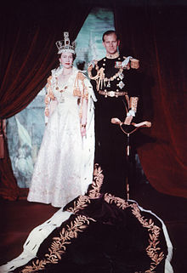
Reign | 6 February 1952 – present
Coronation | 2 June 1953
Predecessor | George VI
Heir apparent | Charles, Prince of Wales
Spouse | Prince Philip, Duke of Edinburgh (m. 1947)
Charles, Prince of Wales Anne, Princess Royal Prince Andrew, Duke of York Prince Edward, Earl of Wessex
Full name Elizabeth Alexandra Mary
House | House of Windsor
Father | George VI
Mother | Elizabeth Bowes-Lyon
Born | 21 April 1926 (age 85) Mayfair, United Kingdom
Religion | Church of England Church of Scotland

