Slide 1
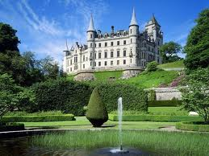
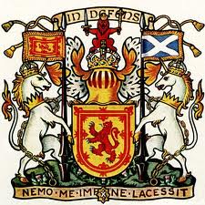
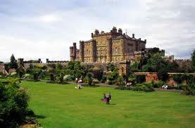
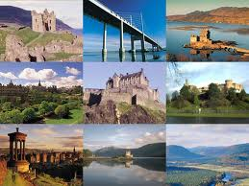
Scotland

Slide 2
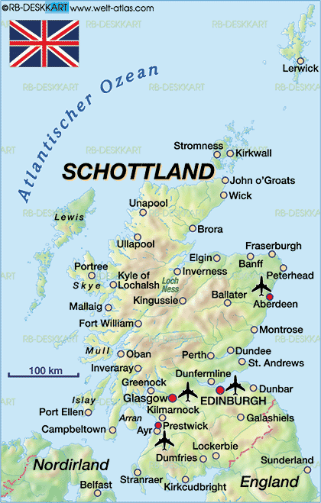
Map of Scotland
Scotland is situated on the northern part of Great Britain

Slide 3
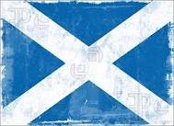
Scotland Flag
The Flag of Scotland is a white X-shaped cross, which represents the cross of the patron saint of Scotland, Saint Andrew on a blue field. The flag is called the Saltire or the Saint Andrew's Cross.

Slide 4
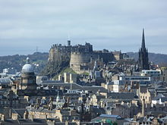
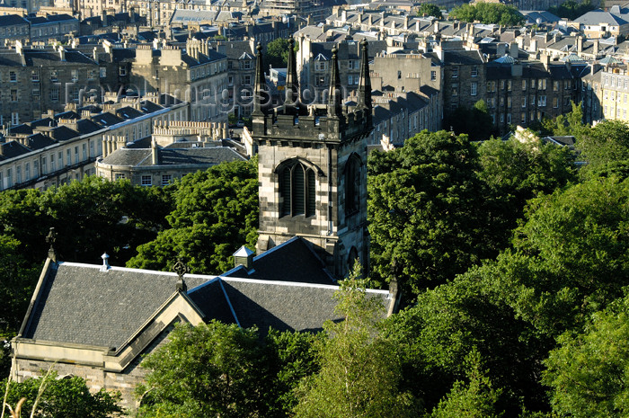
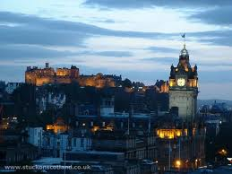
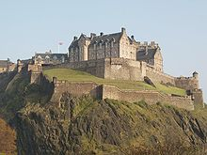
EDINBURGH
Edinburgh is the capital city and second largest city in Scotland. Edinburgh lies on the east coast, where the River Forth flows into the sea.
The central part is Edinburgh Castle, at the top of a steep hill. The castle has a military display every year, called a tattoo, where soldiers show their skills at marching and competitions, and there are brass bands and bands of bagpipes.

Slide 5
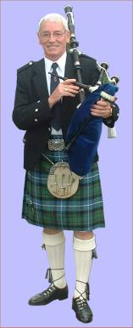
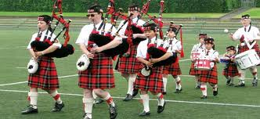
National costumes
Scotland clothing mainly features the tartan which is the traditional dress of Scotland. People of the Highland Scots mostly wear this dress. Kilt was the one of the traditional Scotland dress of the people. The modern Scotland clothing comprises of jackets, sporran, skean dhu, kilt hose and garters. Kilt is only worn by men because it is male garment .Very few people wear tartans and these Scotland traditional dresses are mostly found in the tourist markets. Seldom you can see a tartan trouser or tartan bonnet
.

Slide 6
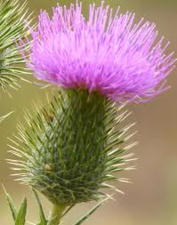
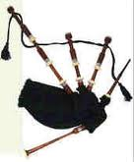
Common throughout the highlands, islands and lowlands of Scotland, the prickly purple thistle has been Scotland's national emblem for centuries. This proud and regal plant, which grows to a height of five feet, has no natural enemies because of the vicious spines that cover and protect it like a porcupine.
The bagpipes are a musical instrument. They are sometimes just called "pipes". They have a bag that holds air. The player keeps the bag full of air by blowing into it with a tube or pumping it with a bellows. To make music, the bag is pressed and the air comes out through a kind of flute or "chanter

Slide 7
Scotland

