Slide 1
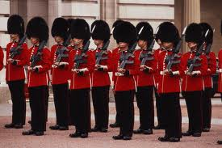
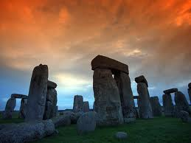

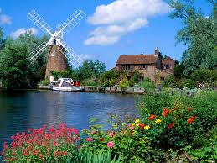
England

Slide 2
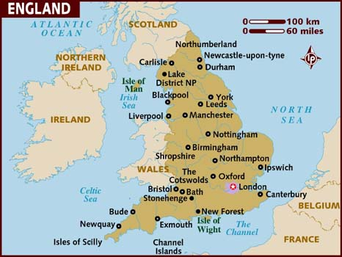
England is the biggest part of the United Kingdom of Great Britain and Northern Ireland . It occupies the central part of island Great Britain.

Slide 3
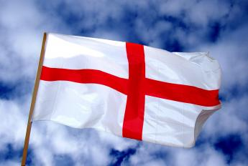
The Flag of England is the St. George's Red Cross on the white background

Slide 4
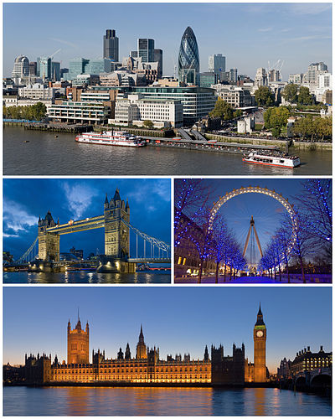
London is the capital of England

Slide 5
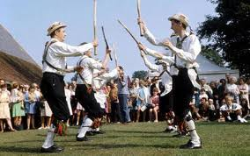
Although England is a country with rich cultural traditions, it has no national costume. The best-known folk costumes are costumes of dancers

Slide 6
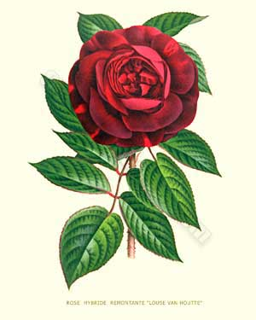
The emblem of England is a red rose

Slide 7
England

