Slide 1
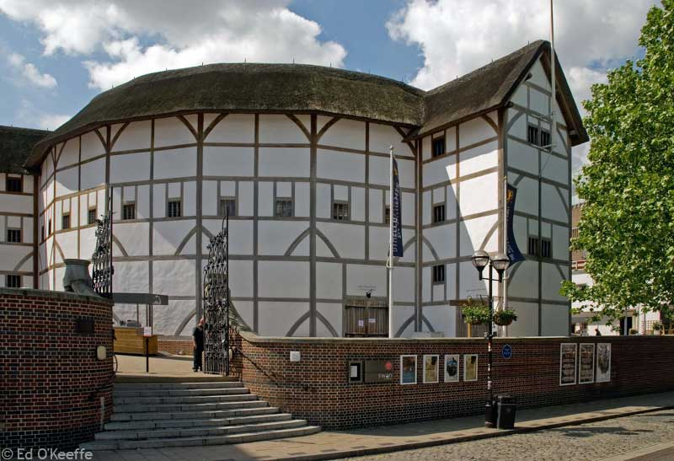
The Globe Theatre

Slide 2
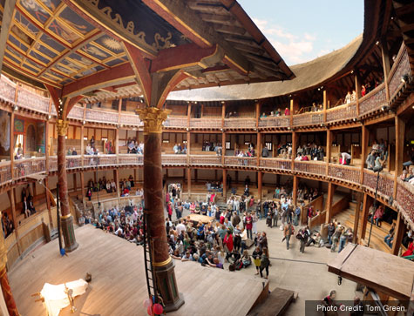
The Globe Theatre was founded by William Shakespeare in 1599;
This theatre was called ”The Globe” because it was round;
In 1613 theatre was destroyed by fire and was opened after the reconstruction only in 1997.

Slide 3
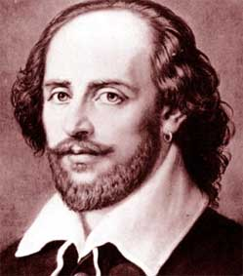
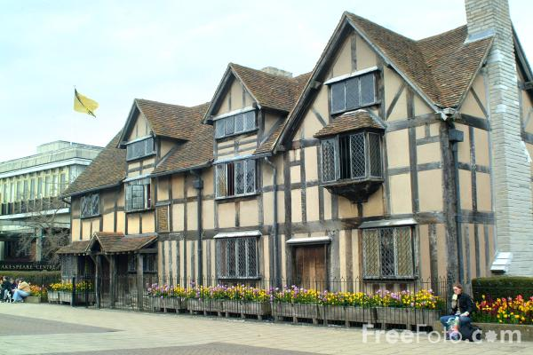
William Shakespeare was born in 1564 in Stratford-on-Avon in the family of glove-maker.
William studied at the grammar school.
He learned English and Latin.

Slide 4
William Shakespeare is an author of 38 plays and many poems.
He wrote histories, tragedies and comedies
His plays are among the best known in English literature.

Slide 5
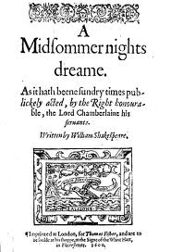
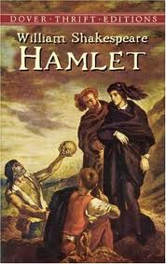
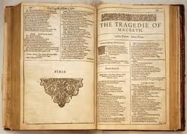
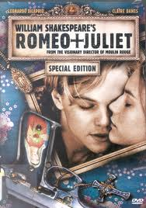
Twelfth Night 1599-1600
Romeo and Juliet 1594-95
Hamlet 1600-01
Othello 1604-05
Macbeth 1605-06
The Tragedy of King Lear

Slide 6
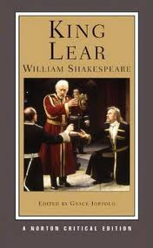
The Tragedy of King Lear

